Slide 1
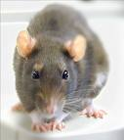
Prisoners’ Dilemma

Slide 2
Assumptions
Strangers.
No communication.
One time only interaction.
Both rational agents.
Notes:
Imagine you are the defense attorney

Slide 3
 | Violet= Silent | Violet= Rat
Scarlet = Silent | Scarlet = Possession 5 years Violet= Possession 5 years | Scarlet = Armed robbery 10 years Violet= Trespassing 2 years
Scarlet = Rat | Scarlet = Trespassing 2 years Violet= Armed robbery 10 years | Scarlet = Armed robbery (lenient) 8 years Violet = Armed robbery (lenient) 8 years
Notes:
Both silent: I have sufficient evidence to convict both of you for something (possession of weapon): 5 years.
Both rat: I’ll convict you both for the serious charge (armed robbery); but take the lowest sentencing option: 8 years
You rat, they don’t: I’ll be able to convict the other person for serious charge (armed robbery); I will convict you for minor (trespassing). 2 years
They rat; you don’t: I’ll convict you of the serious crime (armed robbery): 10 years
*Sucker’s payoff: Cooperate without payoff
*Strictly Dominate: No mater what the other person does, it’s better to do x

Slide 4
 | Violet= Silent | Violet= Rat
Scarlet = Silent | Scarlet = 5 years 2nd Best Violet= 5 years 2nd Best | Scarlet = 10 years Worst Violet= 2 years Best
Scarlet = Rat | Scarlet = 2 years Best Violet= 10 years Worst | Scarlet = 8 years 2nd Worst Violet = 8 years 2nd Worst
Notes:
Both silent: I have sufficient evidence to convict both of you for something (possession of weapon): 5 years.
Both rat: I’ll convict you both for the serious charge (armed robbery); but take the lowest sentencing option: 8 years
You rat, they don’t: I’ll be able to convict the other person for serious charge (armed robbery); I will convict you for minor (trespassing). 2 years
They rat; you don’t: I’ll convict you of the serious crime (armed robbery): 10 years
*Sucker’s payoff: Cooperate without payoff
*Strictly Dominate: No mater what the other person does, it’s better to do x

Slide 5
Scarlet | Violet = Silent | Violet = Rat
Scarlet = Silent | Scarlet = 5 year 2nd Best | Scarlet = 10 years Worst
Scarlet = Rat | Scarlet = 2 years Best | Scarlet = 8years 2nd Worst

Slide 6
Violet | Violet = Silent | Violet = Rat
Scarlet = Silent | Violet= 5 years 2nd Best | Violet = 2 years Best
Scarlet = Rat | Violet= 10 years Worst | Violet= 8 years 2nd Worst

Slide 7
 | Violet = Silent | Violet = Rat
Scarlet = Silent | Scarlet = 2nd Best Violet= 2nd Best | Scarlet = Worst Violet = Best
Scarlet = Rat | Scarlet = Best Violet = Worst | Scarlet = 2nd Worst Violet = 2nd Worst

Slide 8
How is prisoners’ situation unusual?
Removes
Multiple interactions
Tit-for-tat strategies
Reputations
Social/individual bonds
Social norms
Personalities
Notes:
Multiple interactions.
Publicity
Reputation
Step-by-step
Tit for tat games.
Social bonds/norms

Slide 9
Escapes: Change the payoff structure
Make cooperation strictly dominate.
Ways of changing the payoff structure
Punishment
Publicity
Reputation
Relationships:
Merge self-interest with other person’s
Notes:
Punishment
Publicity
Reputation

Slide 10
Larger scale versions
Multiple-people; Multiple-interactions

Slide 11
Many person Prisoners’ Dilemmas
Soldiers
Commuters
Global warming
Overfishing

Slide 12
Overfishing
Notes:
Add carrying capacity chart

Slide 13
 | More than N cooperate | N others cooperate | Fewer than N cooperate
Cooperate | Cost + Benefit | Cost + Benefit | Cost
Defect | Benefit | 0 | 0
Notes:
N= Threshold number
D doesn’t dominate C: when at threshold of N, cooperating is better
Note: My cooperating increases the chances others will

Slide 14
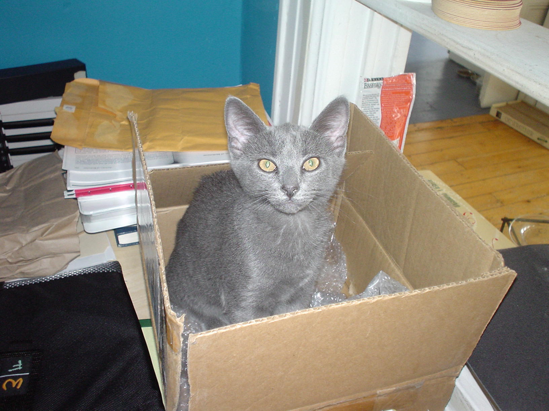
Hobbes

Slide 15
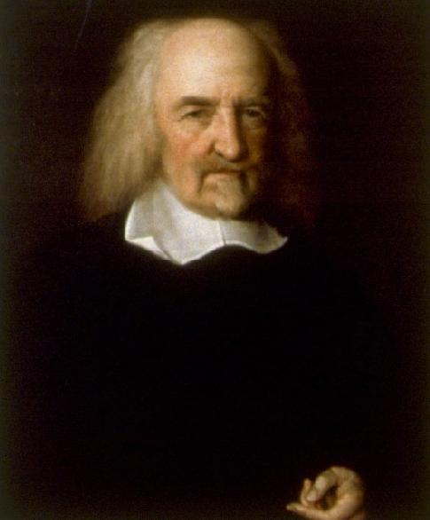
Hobbes

Slide 16
A War of All Against All
Whatsoever therefore is consequent to a time of war, where every man is enemy to every man, the same consequent to the time wherein men live without other security than what their own strength and their own invention shall furnish them withal. In such condition there is no place for industry, because the fruit thereof is uncertain: and consequently no culture of the earth; no navigation, nor use of the commodities that may be imported by sea; no commodious building; no instruments of moving and removing such things as require much force; no knowledge of the face of the earth; no account of time; no arts; no letters; no society; and which is worst of all, continual fear, and danger of violent death; and the life of man, solitary, poor, nasty, brutish, and short.
[Leviathan, XIII]
Notes:
http://oregonstate.edu/instruct/phl302/texts/hobbes/leviathan-c.html

Slide 17
Change the payoff structure
To break out of the trap, something must change the payoff structure
Hobbes: An absolute Sovereign who will punish defectors.
In some cases, ethics/morality can play this role.

Slide 18
Soldiers
Problem:
For each soldier:
Best: She runs, everyone else stays
Worst: She stays, everyone else runs
2nd Best: She stays, everyone else stays
2nd Worst: She runs, Everyone else runs
Solution:
Change self-interest to align with community interest
Band of brothers/sisters
Sacred Band of Thebes
"For men of the same tribe or family little value one another when dangers press; but a band cemented by friendship grounded upon love is never to be broken, and invincible; since the lovers, ashamed to be base in sight of their beloved, and the beloved before their lovers, willingly rush into danger for the relief of one another." --Plutarch

Slide 19
Solutions
Soldiers
Chain to posts; Band of Brothers/Sisters
Overfishing
Regulation
3) Commuters
???
4) Global warming
????????????????????????????????

Slide 20
Tragedy of the commons
Prisoners’ dilemma + collective/iterated/aggregated payoffs
Notes:
Kinda-sorta based on some work by Elinor Ostrom
https://www.nobelprize.org/prizes/economic-sciences/2009/ostrom/biographical/

Slide 21
Warnings
This is not the tragedy of the commons you will find in a quick Google search.
If you are reading about sheep destroying public pastures, you are probably reading about the easy (and fake –thanks Elinor Ostrom) version.

Slide 22
Common mistakes
This version of the ToC arises when people act rationally.
Human stupidity and shortsightedness can cause similar effects, but the ToC actually relies on people behaving rationally.

Slide 23
Rationality, not stupidity
These are tragedies because the worst outcome arises when every person acts rationally. There is no stupidity or irrationality involved.
The reasoning involved does not neglect the fact that if everyone acts as you do, you yourself will be worse off.

Slide 24
Tragedy of the commons (general form)
Individually rational for each person to do x.
If enough people do x, it will be collectively worse (worse for everyone).
If not enough people do x, then the disaster doesn’t happen.
Each individual’s actions on their own produce a negligible effect.
Notes:
When can it arise?
Transparency?
Assumed good will?
Size of effects of defection

Slide 25
Disaster!
Z
N
Safety
margin
Total fish caught
L

Slide 26
Disaster!
Z
N
Safety
margin
Total fish caught
L
Everything’s fine
Everyone is screwed

Slide 27
Definitions
Z
If the # of fish caught is greater than Z, there will not be enough fish to replenish supply
If the # of fish caught is less than or equal to Z, there will be no disaster.
L
We set a limit L for the total number of fish to give us a safety margin
N
The # of fish in the safety margin
N = Z - L
N is the number of people who can cheat by catching 1 extra fish without causing a disaster

Slide 28
Example
Z = 1,000 fish
L = 900 fish
N = 100 people catching 1 extra fish each

Slide 29
How do we escape Tragedies of the Commons?

Slide 30
Carrying Capacity
Overpopulation
Z
Current population

Slide 31
Population as a Tragedy of the commons
Z = Number of third kids sufficient for overpopulation.
N = Number of women who actually have three kids.
If enough people do x, there will be overpopulation.
If N ≥ Z, then exceed carrying capacity
If not enough people do x, then there will not be overpopulation.
If N < Z, then no overpopulation

Slide 32
Prisoners’ Dilemma: Original

Slide 33
 | Azure = Silent | Azure = Rat
Scarlet = Silent | Scarlet = 6 Months (2nd worst) Azure = 6 Months (2nd worst) | Scarlet = 10 years (worst) Azure = Free (best)
Scarlet = Rat | Scarlet = Free (best) Azure = 10 years (worst) | Scarlet = 2 years (2nd best) Azure = 2 years (2nd best)
Notes:
Deal offered
Both silent: I have sufficient evidence to convict both of you for something (trespassing).
You rat: I’ll be able to convict the other person for serious charge (armed robbery or something); I will charge you for something more minor (loitering).
You know
If we both rat, she will be able to charge both an additional crime (conspiracy).

Slide 34
Prisoners’ Dilemma: tricky

Slide 35
 | Azure = Silent | Azure = Rat
Scarlet = Silent | Scarlet = 5 years Azure = 5 years | Scarlet = 10 years Azure = 1 year
Scarlet = Rat | Scarlet = 1 year Azure = 10 years | Scarlet = 15 years Azure = 15 years
Notes:
Deal offered
Both silent: I have sufficient evidence to convict both of you for something (trespassing).
You rat: I’ll be able to convict the other person for serious charge (armed robbery or something); I will charge you for something more minor (loitering).
You know
If we both rat, she will be able to charge both an additional crime (conspiracy).

Slide 36
Scarlet’s Matrix | Azure = Silent | Azure = Rat
Scarlet = Silent | Scarlet = 5 years 2nd Best for Scarlet | Scarlet = 10 years 2nd Worst for Scarlet
Scarlet = Rat | Scarlet = 1 year Best for Scarlet | Scarlet = 15 years Worst for Scarlet

Slide 37
Scarlet’s reasoning: RAT
Ranking of outcomes:
Best: 1 year (Rat)
2nd best: 5 years (Silent)
2nd worst: 10 years (Silent)
Worst: 25 years (Rat)
My self interest= Serve the least amount of time.
Therefore, I should Rat
Indeed,, if we

Slide 38
Scarlet’s reasoning: Rat

Slide 39
Not rat
But the choice shouldn’t be made by just looking at the numbers individually. Each choice has is a risk.
Ratting gives me either the best or worst outcome.
Both consequences of remaining silent are better than worst outcome.
Therefore, better to not rat.
I know that Scarlet will decide to not rat. Therefore, I can get my best outcome if I rat.
But I know that the other person will reason in the same way.
Thus she knows I’ll stay silent.
Her best outcome is her ratting if I stay silent.
Therefore, I know that if I stay silent I will get my 2nd worst outcome.
So, I know that she will Rat because she knows that I want to avoid the worst outcome.

Slide 40
Azure’s Matrix | Azure = Silent | Azure = Rat
Scarlet = Silent | Azure = 5 years 2nd Best for Azure | Azure = 1 year Best for Azure
Scarlet = Rat | Azure = 10 years 2nd worst for Azure | Azure =15 years Worst for Azure

Slide 41
Both | Azure = Silent | Azure = Rat
Scarlet = Silent | Scarlet = 2nd Best Azure = 2nd Best | Scarlet = 2nd Worst Azure = Best
Scarlet = Rat | Scarlet = Best Azure = 2nd Worst | Scarlet = Worst Azure = Worst

Slide 42
Older

